Slide 1
Impacts of War and Chemical Spills
Chernobyl
Agent Orange
World’s Largest Oil Spill

Slide 2
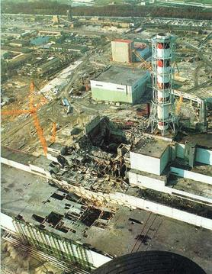
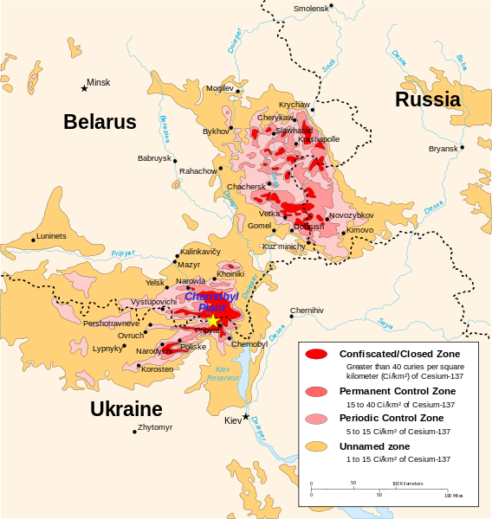
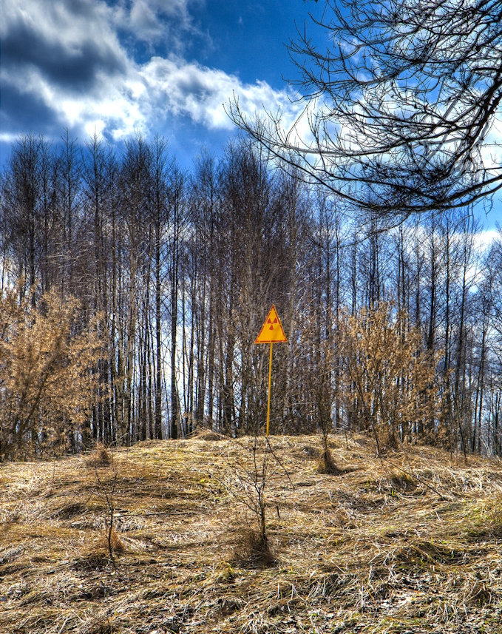
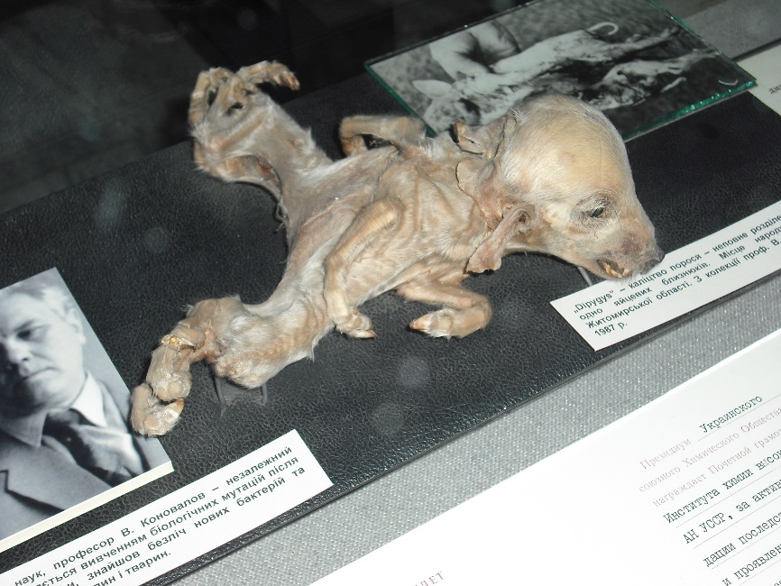
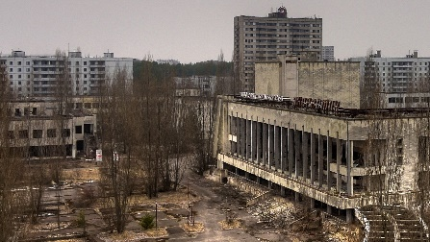
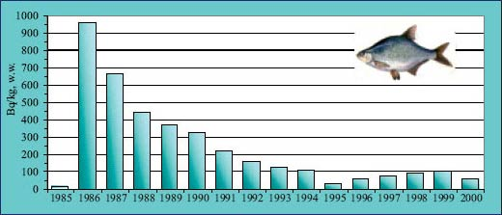
Chernobyl
Occurred 26 April 1986
First few years extreme effects
Over time effects lessened
Today barely extreme, very moderate

Slide 3
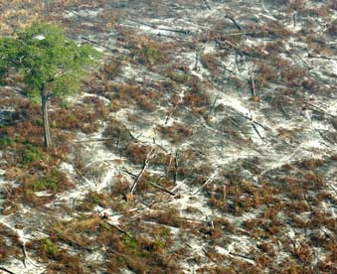
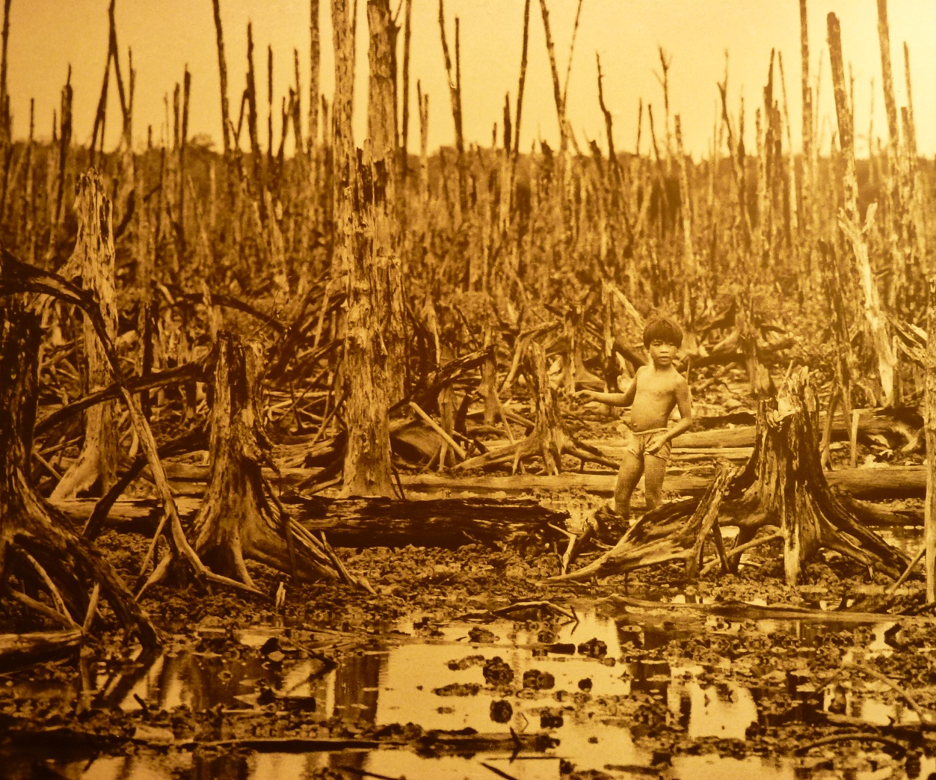
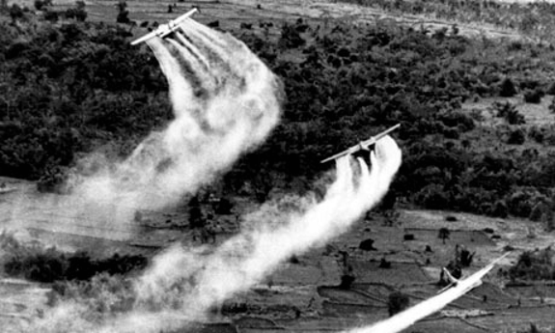
Agent Orange

Slide 4
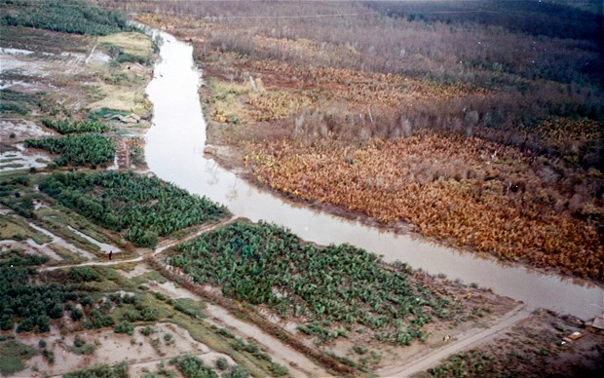
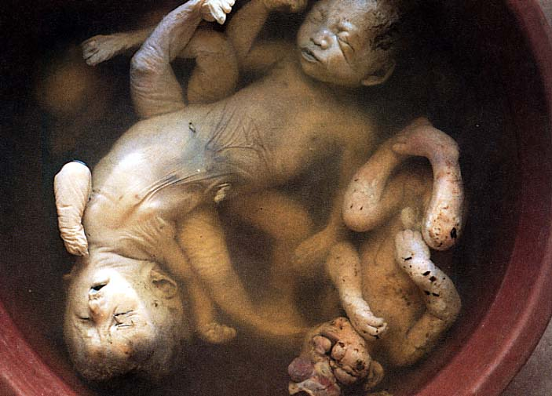
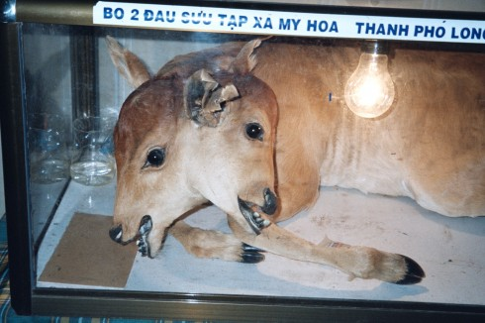
Agent Orange

Slide 5
Mexican Gulf Oil Spill
April 20 2010, the BP contracted Transocean Ltd oil rig explodes in the Mexican Gulf.
Kills 11 people.
Two days later, it sinks and oil begins to leak.

Slide 6
The Spread
Almost 800,000 litres are leaked EACH DAY.
A decent 795 million litres are leaked after 86 days.
Covered 75,000 kilometres squared.

Slide 7
The Environmental Impact
Underwater plumes as big as 5km long and 100m thick depleted oxygen levels on all trophic levels, devastating marine life.
Affected 8,332 species of plants and animals.
Notes:
Floating oil can contaminate plankton, which includes algae, fish eggs, and the larvae of various invertebrates.
Long term damage to lower trophic levels is difficult to assess, but could pose ecological risks in the Gulf of Mexico for years, based upon interference with metabolic functions of thousands of species; benthic organisms in the inner and outer continental shelves could be affected from oil coating of substantial portions of the ocean floor.
Birds can be exposed to oil as they float on the water or dive for fish through oil-slicked water.
Oiled birds can lose the ability to fly and can ingest the oil while preening.
Sea turtles such as loggerheads and leatherbacks can be impacted as they swim to shore for nesting activities.
Turtle nest eggs may be damaged if an oiled adult lies on the nest.
Scavengers such as bald eagles, gulls, raccoons, and skunks are also exposed to oil by feeding on carcasses of contaminated fish and wildlife.
Oil chemical causes irregular heartbeat in tuna embryo leading to heart attacks and death for generations to come.

Slide 8
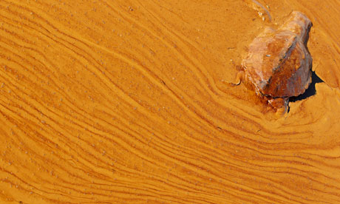
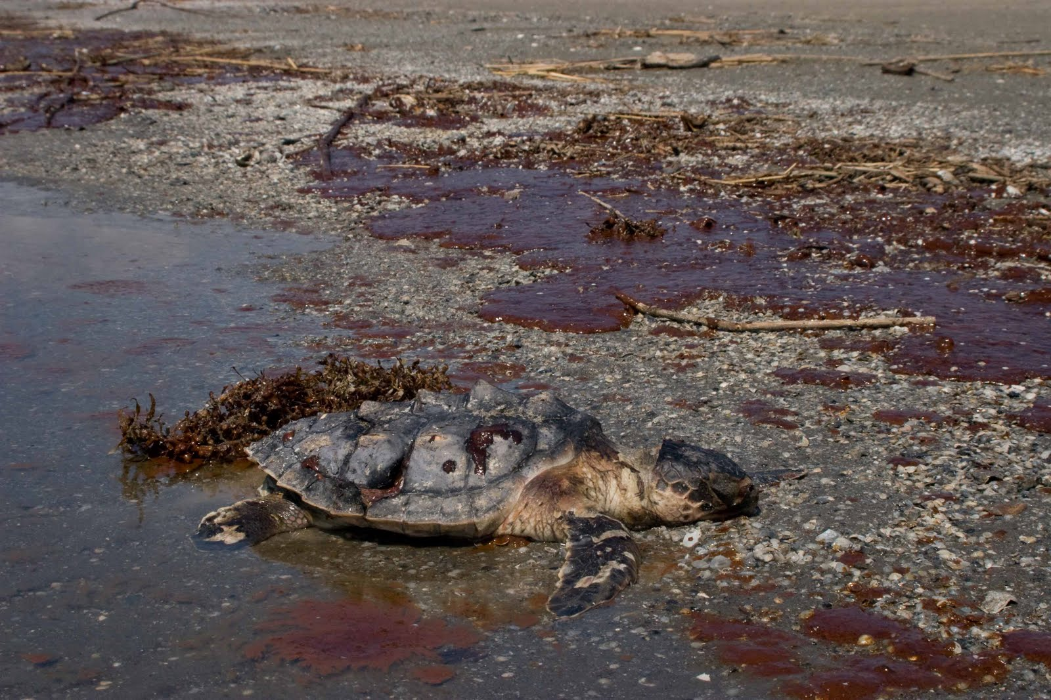
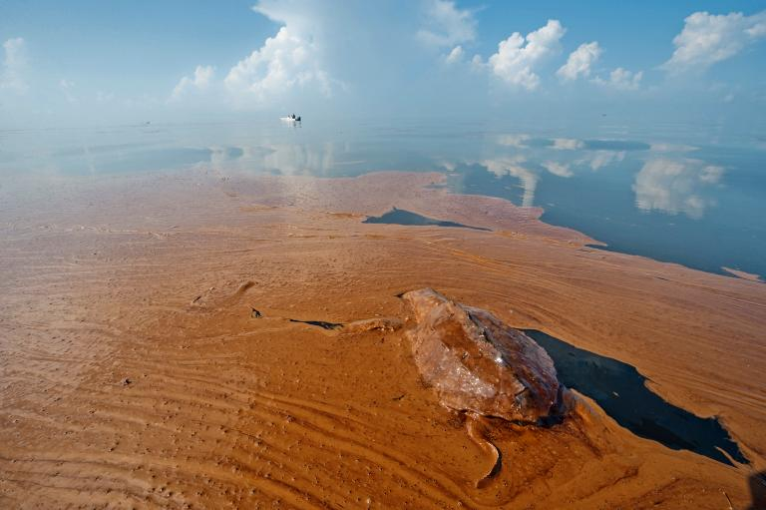
Notes:
500 turtles died each year after 2011

Slide 9
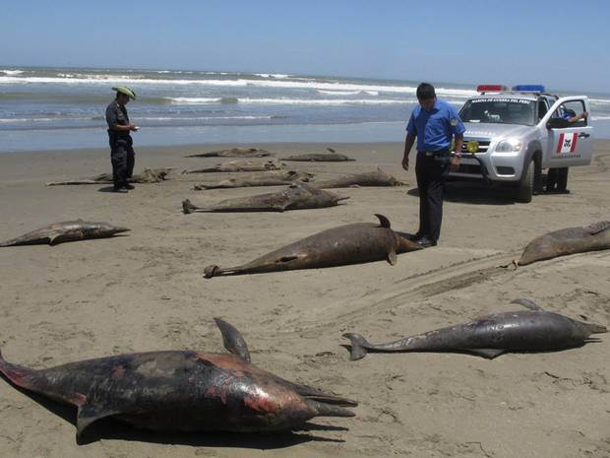
Notes:
900 dolphins died or were stranded due to the oil spill.

Slide 10
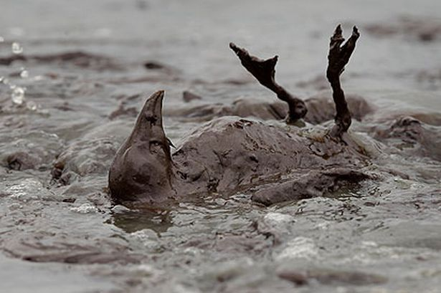

Slide 11
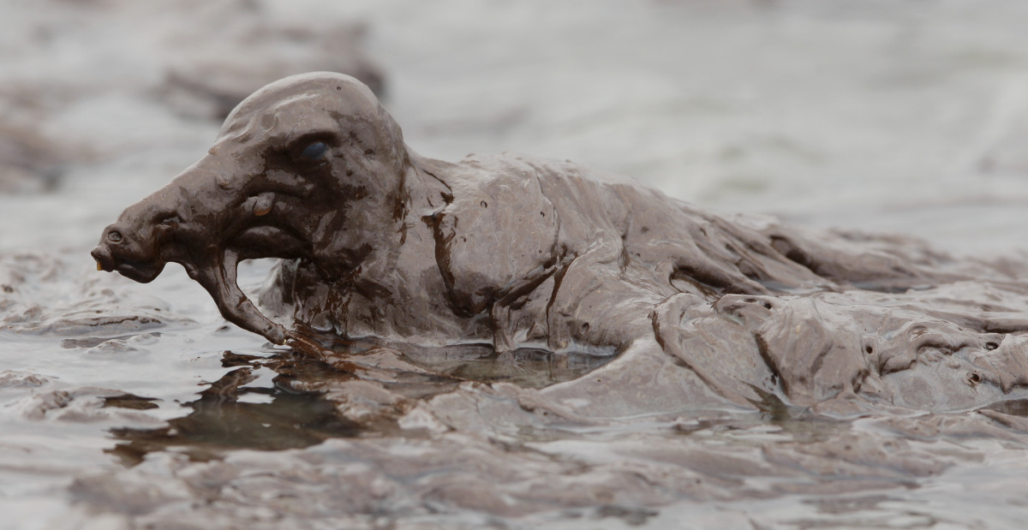

Slide 12
